Slide 1
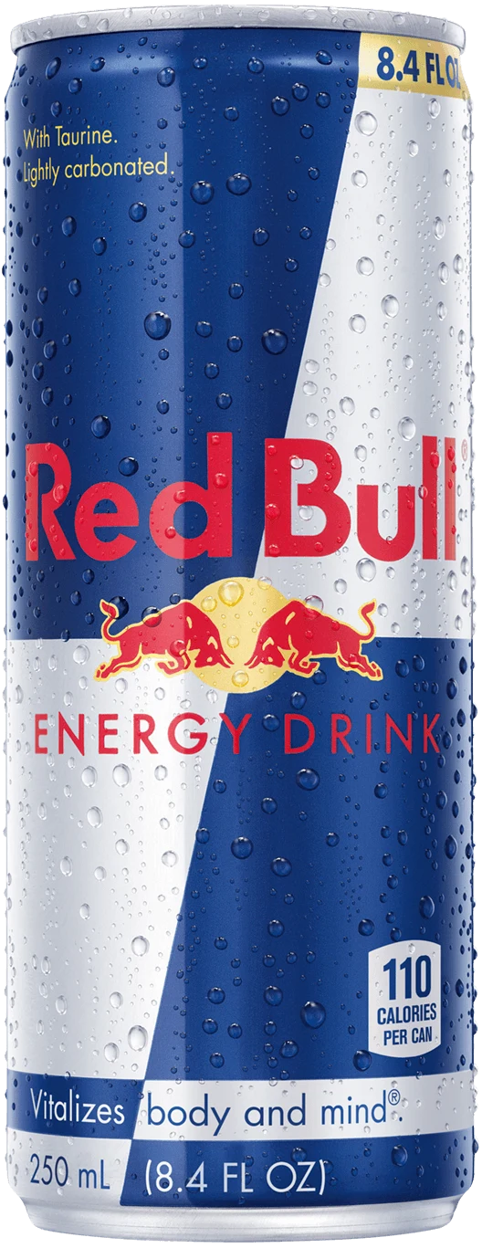
Red Bull: Increasing Sales with EMRECo
Recommendations for Improving Our Relationship and Growing Our Business

Slide 2
Executive summary
Red Bull - Key Account Manager Recommendations
Increase our presence in these stores. We are currently not present in a third of their stores. This will allow us to reach more customers and increase sales.
Replace aging ColaCo coolers with Red Bull coolers. Our coolers generate more sales than ColaCo coolers, on average $1,350 versus $800. Replacing aging ColaCo coolers with our Red Bull coolers will lead to increased sales.
Highlight our superior margins. Red Bull margins are 35%, which is 15 percentage points higher than ColaCo. This should be very enticing to them, especially since their own data shows that their Red Bull margins grow with an increase in unit sales.
Assess inventory levels. EMRECo is also concerned about inventory levels. I will talk to their category manager to see if this is an area of opportunity for us.
Click on link to access the data

Slide 3
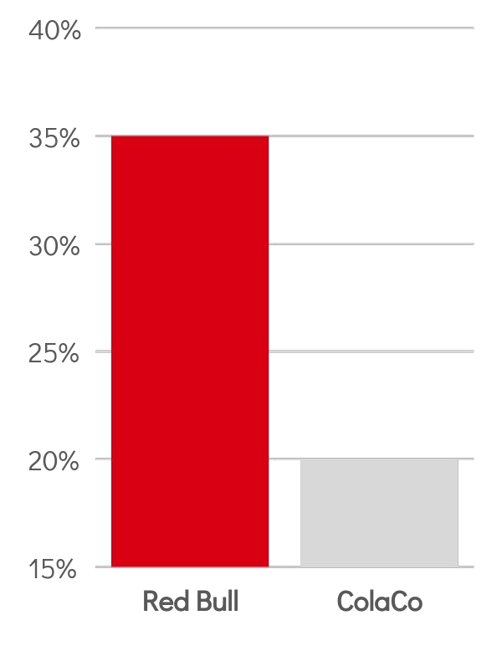
Red Bull / EMRECo relationship:
Red Bull margins outperform ColaCo by 15 percentage points
Margins: Red Bull margins are 35%, which is 15 percentage points higher than ColaCo's.
Total sales: EMRECo currently stocks Red Bull in over 500 of their stores, and Red Bull sales in these stores are averaging $1,350 per store.
Questions / concerns: EMRECo has expressed concerns about margins, inventory levels, and the aging of their ColaCo coolers.
Red Bull has delivered strong results for EMRECo in Q1 2023
Total sales:
$551K
Q1 2023

Slide 4
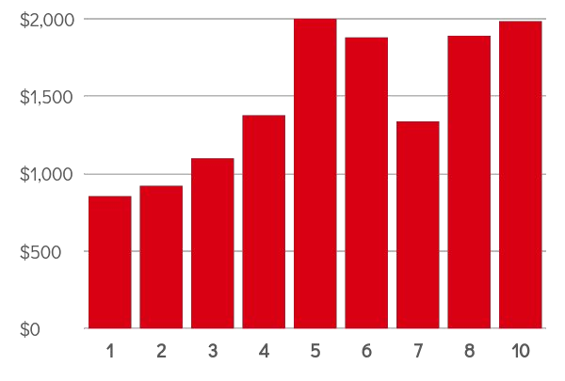
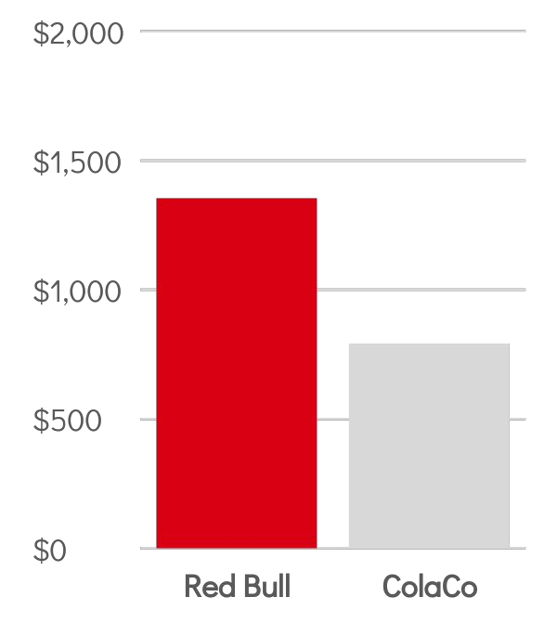
Opportunity :
Recommendation #1:
Replace aging ColaCo coolers with Red Bull Coolers
1. Increase our presence in their stores.
We are currently not present in a third of their stores.
I will encourage them to start stocking us in these locations.
This will allow us to reach more customers and increase sales.
Our coolers generate more sales than ColaCo coolers.
On average, a Red Bull cooler delivers $1,350 in sales, while a ColaCo cooler delivers only $800.
More Red Bull coolers per store leads to increased sales.
2. Replace their aging ColaCo coolers with our Red Bull coolers.
A higher number of coolers drives higher sales volume per cooler
Sales per Cooler ($)

Slide 5
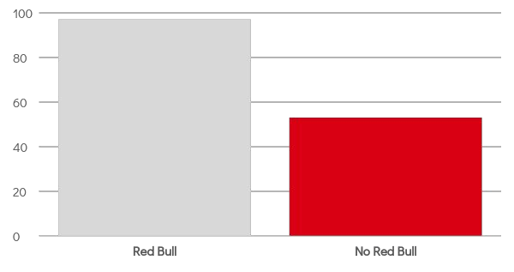
Opportunity :
Recommendation #2:
3. Highlight our superior margins.
Start selling Red Bull in remaining 53 EMRECo locations
EMRECo is concerned about margins.
We have data to show that our margins are far superior to ColaCo's.
This should be very enticing to them, especially since their own data shows that their Red Bull margins grow with an increase in unit sales.
4: Assess inventory levels and increase counter
# locations
Determine logistics to ensure Red Bull is stocked in remaining 53 stores; plan to complete Red Bull launch in stores
EMRECo is also concerned about inventory levels.
The customers have been complaining about products not being sold out at all counters.
I will talk to their category manager to see if this is an area of opportunity for us.

Slide 6
Proposed Next Steps
Determine logistics to ensure Red Bull is stocked in remaining 53 stores; plan to complete Red Bull launch in stores by end of Q2.
Determine a plan to phase in Red Bull coolers to replace aging ColaCo coolers and discuss pricing and ﬁnancing options.
Investigate RB inventory levels to determine if there is an issue.
I believe that these recommendations will help us to improve our relationship with EMRECo and increase sales of Red Bull. I will keep you updated on my progress.

Slide 7
Thank you

